Slide 1

.NET Core: Developing Cross-Platform Web Apps with ASP.NET Core – WorkshopPLUS
< Engineer Name >
Premier Field Engineer
v3.1

Slide 2
Active Directory, Azure, IntelliSense, Internet Explorer, Microsoft, Microsoft Corporate Logo, Silverlight, SharePoint, SQL Server, Visual Basic, Visual Studio, Windows, Windows Server, and Windows Vista are either registered trademarks or trademarks of Microsoft Corporation in the United States and/or other countries. Other Microsoft products mentioned herein may be either registered trademarks or trademarks of Microsoft Corporation in the United States and/or other countries. All other trademarks are property of their respective owners.

Slide 3
Module 1: Overview
Module Overview
Notes:
This module discusses the following sections:
Section 1: Design Patterns
Section 2: ASP.NET
Section 3: ASP.NET Core
After completing this module, you will be able to:
Understand the fundamental concepts of MVC design pattern.
Compare MVC with Web Forms and Web Pages
Understand how ASP.NET Core brings together all the three web development models.
Understand the major differences and enhancements made in ASP.NET Core.

Slide 4
Module 1: Overview
Section 1: .NET Platform
Lesson: Overview

Slide 5
.NET
Free. Cross-platform. Open source.
A developer platform for building all your apps.
www.dot.net

Slide 6
What is .NET?
Notes:
So what is .NET?

Slide 7














Your platform for building anything
DESKTOP
WEB
CLOUD
MOBILE
GAMING
IoT
AI
.NET
Notes:
You can build anything with .NET. From desktop apps to cloud-native services, iPhone and Android mobile apps to artificial intelligence, you can build almost anything with the .NET platform.

Slide 8

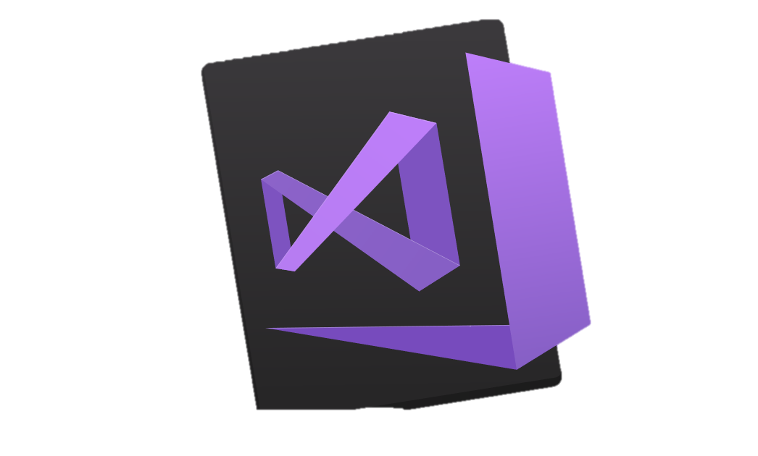


.NET is a software development platform
TOOLS
DESKTOP
WEB
CLOUD
MOBILE
GAMING
IoT
AI
VISUAL STUDIO
.NET STANDARD
VISUAL STUDIO FOR MAC
LIBRARIES
VISUAL STUDIO CODE
INFRASTRUCTURE
RUNTIME COMPONENTS
COMPILERS
LANGUAGES
COMMAND LINE INTERFACE
Notes:
.NET is an entire software development platform that takes care of a lot of the heavy lifting for you when you want to build an application. Applications frameworks help you build the specific types of apps or workloads and enable you to literally build any app for any platform with any operating system. Each .NET workload shares a common infrastructure and .NET Standard library. This means not only are your .NET skills portable, but your actual code is portable no matter what you’re building. This makes it easy to share reusable components (called libraries) across the breadth of applications people build.
Additionally, there are a broad set of development tools that makes it really productive to write, debug, build and manage code bases.
See: www.dot.net

Slide 9
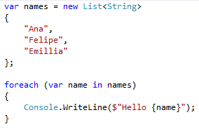
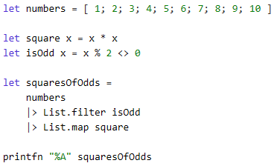
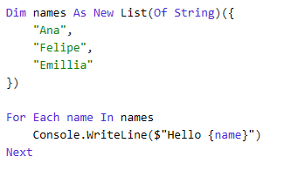
You can write code with many .NET languages
C# (c-sharp)
C# is a simple, modern, object-oriented, and type-safe programming language
Its roots in the C family of languages makes C# immediately familiar to C, C++, Java, and JavaScript programmers
F# (f-sharp)
F# is a cross-platform, open-source, functional programming language for .NET
It also includes object-oriented and imperative programming
Visual Basic
Visual Basic is an approachable language with a simple syntax for building type-safe, object-oriented apps
Notes:
(Speak to slide bullet points.)

Slide 10
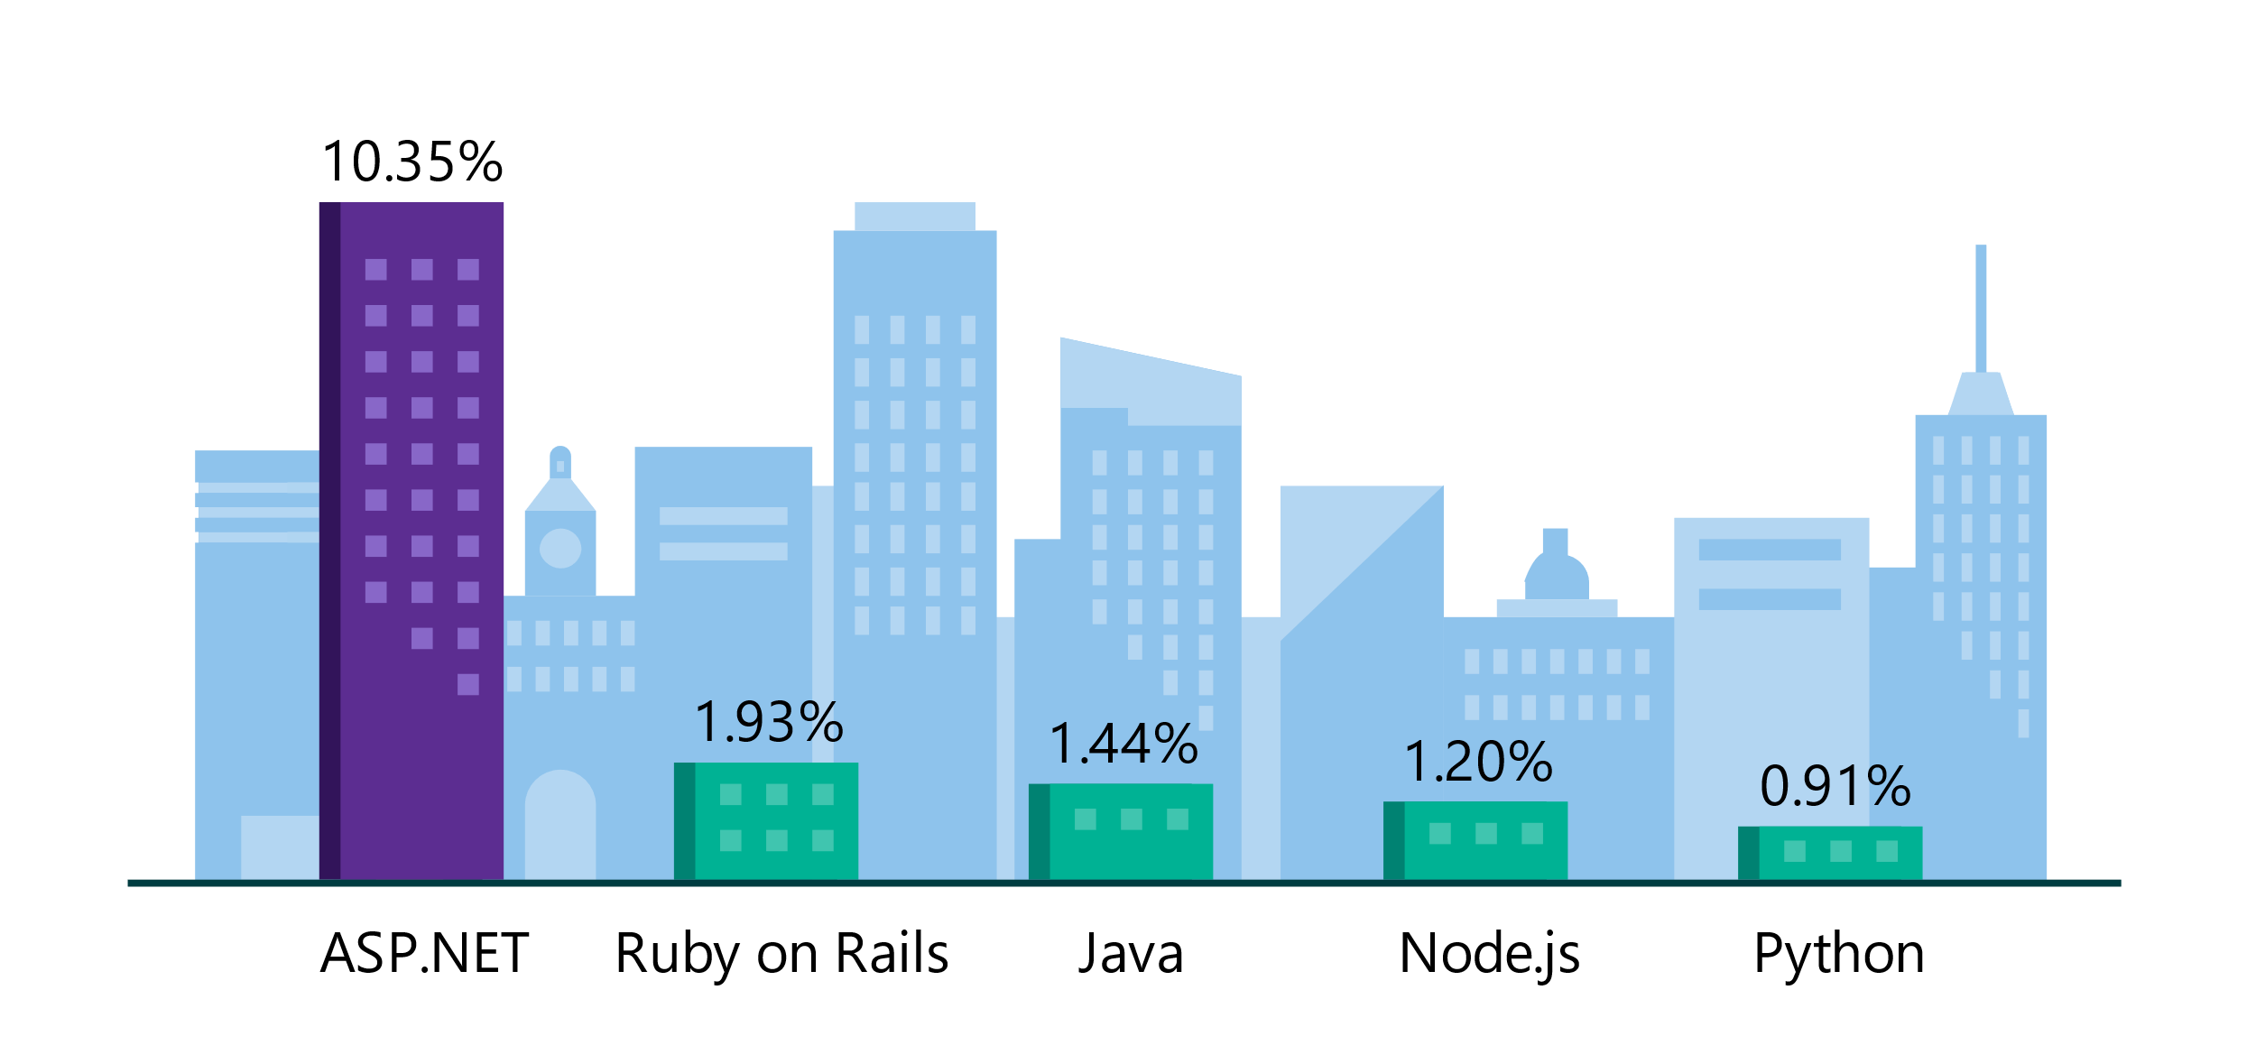
.NET is the platform of choice for the top 100K websites
More websites have been developed with ASP.NET than Ruby, Java, Python, Node.js, and Go combined.
Companies like Raygun, GoDaddy, and Tencent choose .NET for better performance, increased flexibility, and higher compatibility.
Data sourced from SimilarTech
Notes:
https://www.similartech.com/categories/framework
ASP.NET is the name of the web framework for .NET. As you can see there are more top websites developed with .NET than these other technologies. Only PHP has more.

Slide 11
.NET is Fast. Really Fast!
2.22M
0.73M
requests / sec
0.53M
requests / sec
requests / sec
Java Servlet
.NET Core
Node.js
Data sourced from official tests available at TechEmpower Round 15.
“Using the same-size server, we were able to go from 1,000 requests per second per node with Node.js to 20,000 requests per second with .NET Core.“ — Raygun
https://www.microsoft.com/net/customers
Notes:
.NET is fast. Really fast! That means applications provide better response times and require less compute power. StackOverflow serves 5.3M page views a day on just 9 servers!
The popular TechEmpower benchmark compares web application frameworks with tasks like JSON serialization, database access, and server side template rendering - .NET performs faster than any other popular framework.
https://www.techempower.com/benchmarks/#section=data-r14&hw=ph&test=plaintext
The community has played a crucial role in performance work for the .NET stack.
https://blogs.msdn.microsoft.com/dotnet/tag/performance/

Slide 12


.NET is Open Source
Community Accepted PRs
“Samsung is embracing .NET because it is a completely open source project.” — Samsung
".NET is open source; that allows us to contribute back to it if we have any performance issues which Microsoft review and together we make a better product.“ — Illyriad Games
16,000+ Community Contributions from 3000+ Companies outside Microsoft
Notes:
We’ve seen companies taking a bet on .NET because it’s a completely open source project. More than 16,000 contributors* from 3300 companies have contributed to .NET Core and related open source repositories, with over half of the contributions coming from outside Microsoft.
Samsung is a big partner and are releasing their new Smart TVs that support .NET. They plan to expand to all their IoT devices too. Illyriad Games, specifically Ben Adams, contributed many performance enhancements to the platform. They build a MMO with hundreds of thousands of concurrent users so performance is super important to them. These enhancements not only benefit them but everyone that uses .NET.
*contributor = Submitted a Pull Request or Created an Issue

Slide 13


Steeltoe
.NET Core
Microsoft Web Protection Library
MSBuild
DotNetNuke
ASP.NET AJAX Control Toolkit
ASP.NET Core
SourceLink
Microsoft Azure WebJobs SDK
Salesforce Toolkits for .NET
nUnit
MVVM Light Toolkit
IronPython
Mailkit
WorldWide Telescope
Nancy
Open XML SDK
.NET SDK for Hadoop
MvvmCross
MEF
Mimekit
xUnit
ASP.NET Web Pages
NuGet
IdentityManager
Couchbase Lite for .NET
iOS
macOS
Entity Framework
.NET ECOSYSTEM
WCF
ILMerge
Xamarin.Mobile
ASP.NET SignalR
.NET Micro Framework
Open Live Writer
Mono
Xamarin.Auth
Xamarin SDK
Orchard CMS
OWIN Authentication Middleware
ProtoBuild
IdentityServer
Microsoft Azure SDK for .NET
.NET Compiler Platform ("Roslyn")
Prism
ASP.NET Web API
Cake
Orleans
Kudu
Cecil
LLILC
Umbraco
System.Drawing
ASP.NET MVC
Notes:
The .NET Foundation is our center of gravity for open development and collaboration around the .NET ecosystem. The .NET Foundation has over 60 projects and hundreds of repos under its stewardship. Open Source Software foundations provide protection, support, services and best practices for helping each project be successful and to grow the ecosystem of people and software.

Slide 14
.NET Core
.NET Core
ASP.NET Core
EF Core
Source License
MIT
Apache 2
Apache 2
Binary License
Microsoft EULA
Microsoft EULA
Microsoft EULA
Acquisition
Installer
Package-Manager
NuGet
NuGet
NuGet
OSes
Windows
macOS
Linux
Same
Same
App Deployment
Runtime-dependent
Self-contained
Docker
Same
Side-by-side installs
Yes!
Yes!
Yes!

Slide 15
.NET Framework or .NET Core 🤔
Which one to choose for building server apps?
.NET Framework | .NET Core
Current application runs on .NET framework. Recommended to extend it instead of migrating. | Cross-platform needs
Need 3rd party libraries not available on .NET Core | Targeting microservices
Need .NET technologies not available on .NET Core | Using Docker containers
Need a platform not supported by .NET Core | Need high performance & scalable systems
 | Side-by-side .NET versions by application
 | Fully open-source
Notes:
What is .NET Core?
.NET Core is a modular version of the .NET Framework that is designed to be portable across platforms.
.NET Core is portable across platforms because, although a subset of the full .NET Framework, it provides key functionality to implement the app features you need and reuse this code regardless of your platform target. In the past, different versions of .NET for different platforms lacked shared functionality for key tasks such as reading local files. Microsoft platforms that you will be able to target with .NET Core include traditional desktop Windows, as well as Windows devices and phones. When used third-party tools such as Xamarin, .NET Core should be portable to iOS and Android devices. In addition, .NET Core will be available for the Mac and Linux operating systems to enable web apps to run on those systems.
.NET Core is modular because it is released in smaller assembly packages. Rather than one large assembly that contains most of the core functionality, .NET Core is made available as smaller feature-centric packages. This enables a more agile development model for us and allows you to pick and choose the functionality pieces that you need for your apps and libraries.

Slide 16
Demo:
Create Console App
Notes:
This should be quick demo
Create Console App on both .NET framework and .NET core
Show that both are built from a similar code and runs the same

Slide 17
Module 1: Overview
Section 1: .NET Platform
Lesson: .NET Standard

Slide 18
.NET Before – Reuse Code!
.NET FRAMEWORK
.NET CORE
XAMARIN
APP
MODELS
WPF
Windows Forms
UWP
iOS
Android
ASP.NET
ASP.NET Core
OS X
BASE
LIBRARIES
.NET Framework BCL
.NET Core BCL
Mono BCL
Notes:
Notes: Even if we are reusing a lot across components (especially with the open sourcing last year), the reality is that each platform has its own implementation of the base libraries.
Note: .NET Framework BCL and Mono BCL are the same APIs, different implementation. .NET Core “Core Library” is a similar set of APIs, but different.

Slide 19
.NET Now
.NET FRAMEWORK
.NET CORE
XAMARIN
APP
MODELS
WPF
Windows Forms
UWP
iOS
Android
ASP.NET
ASP.NET Core
OS X
BASE
LIBRARIES
.NET Standard

Slide 20
.NET Standard Library
Goal: Establish greater uniformity in the .NET ecosystem
A set of APIs that all .NET platforms have to implement
Unifies the .NET platform and prevents future fragmentation
.NET Standard will replace Portable Class Libraries (PCLs)
Addresses three main scenarios:
Defines uniform set of BCL APIs for all .NET platforms to implement, independent of workload
Enables developers to produce portable libraries that are usable across .NET runtimes, using the same set of APIs
Reduces and hopefully eliminates conditional compilation of shared source due to .NET APIs
Notes:
https://docs.microsoft.com/en-us/dotnet/articles/standard/library
The .NET Standard is a formal specification of .NET APIs that are intended to be available on all .NET implementations. The motivation behind the .NET Standard is establishing greater uniformity in the .NET ecosystem.

Slide 21
.NET Standard Versions
.NET Standard | 1.0 | 1.1 | 1.2 | 1.3 | 1.4 | 1.5 | 1.6 | 2.0 | 2.1
.NET Core | 1.0 | 1.0 | 1.0 | 1.0 | 1.0 | 1.0 | 1.0 | 2.0 | 3.0
.NET Framework ¹ | 4.5 | 4.5 | 4.5.1 | 4.6 | 4.6.1 | 4.6.1 ² | 4.6.1 ² | 4.6.1 ² | N/A³
Mono | 4.6 | 4.6 | 4.6 | 4.6 | 4.6 | 4.6 | 4.6 | 5.4 | 6.4
Xamarin.iOS | 10.0 | 10.0 | 10.0 | 10.0 | 10.0 | 10.0 | 10.0 | 10.14 | 12.16
Xamarin.Mac | 3.0 | 3.0 | 3.0 | 3.0 | 3.0 | 3.0 | 3.0 | 3.8 | 5.16
Xamarin.Android | 7.0 | 7.0 | 7.0 | 7.0 | 7.0 | 7.0 | 7.0 | 8.0 | 10.0
Universal Windows Platform | 10.0 | 10.0 | 10.0 | 10.0 | 10.0 | 10.0.16299 | 10.0.16299 | 10.0.16299 | TBD
Unity | 2018.1 | 2018.1 | 2018.1 | 2018.1 | 2018.1 | 2018.1 | 2018.1 | 2018.1 | TBD
.NET Framework won't support .NET Standard 2.1 or later versions.
Notes:
Link: https://docs.microsoft.com/en-us/dotnet/standard/net-standard
The versions listed for .NET Framework apply to .NET Core 2.0 SDK and later versions of the tooling. Older versions used a different mapping for .NET Standard 1.5 and higher. You can download tooling for .NET Core tools for Visual Studio 2015 if you cannot upgrade to Visual Studio 2017 or a later version.
The versions listed here represent the rules that NuGet uses to determine whether a given .NET Standard library is applicable. While NuGet considers .NET Framework 4.6.1 as supporting .NET Standard 1.5 through 2.0, there are several issues with consuming .NET Standard libraries that were built for those versions from .NET Framework 4.6.1 projects. For .NET Framework projects that need to use such libraries, we recommend that you upgrade the project to target .NET Framework 4.7.2 or higher.
.NET Framework won't support .NET Standard 2.1 or later versions. For more details, see the announcement of .NET Standard 2.1.

Slide 22
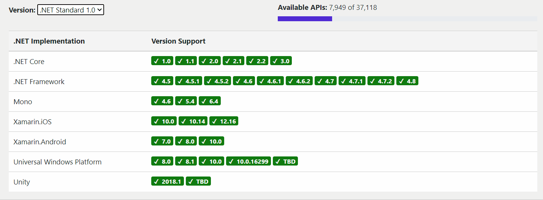
.NET Standard Versions Illustration
Source: https://dotnet.microsoft.com/platform/dotnet-standard

Slide 23
What version should you target?
The higher the version, the more APIs you have
The lower the version, the more platforms support it
Target the lowest version you can get away with!
Lower Version
Higher Version
More Reach
More APIs

Slide 24
APIs in .NET Standard 2.0
XML
XLinq • XML Document • XPath • Schema • XSL
SERIALIZATION
BinaryFormatter • Data Contract • XML
NETWORKING
Sockets • HTTP • Mail • WebSockets
IO
Files • Compression • MMF
THREADING
Threads • Thread Pool • Tasks
CORE
Primitives • Collections • Reflection • Interop • Linq

Slide 25
APIs in .NET Standard 2.1
Span<T>
Foundational-APIs working with spans
Reflection emit
SIMD
ValueTask and ValueTask<T>
DbProviderFactories
General Goodness
Notes:
More details can be found at https://devblogs.microsoft.com/dotnet/announcing-net-standard-2-1/
Span<T>. In .NET Core 2.1 we’ve added Span<T> which is an array-like type that allows representing managed and unmanaged memory in a uniform way and supports slicing without copying. It’s at the heart of most performance-related improvements in .NET Core 2.1. Since it allows managing buffers in a more efficient way, it can help in reducing allocations and copying. We consider Span<T> to be a very fundamental type as it requires runtime and compiler support in order to be fully leveraged. If you want to learn more about this type, make sure to read Stephen Toub’s excellent article on Span<T>.
Foundational-APIs working with spans. While Span<T> is available as a .NET Standard compatible NuGet package (System.Memory) already, adding this package cannot extend the members of .NET Standard types that deal with spans. For example, .NET Core 2.1 added many APIs that allow working with spans, such as Stream.Read(Span<Byte>). Part of the value proposition to add span to .NET Standard is to add theses companion APIs as well.
Reflection emit. To boost productivity, the .NET ecosystem has always made heavy use of dynamic features such as reflection and reflection emit. Emit is often used as a tool to optimize performance as well as a way to generate types on the fly for proxying interfaces. As a result, many of you asked for reflection emit to be included in the .NET Standard. Previously, we’ve tried to provide this via a NuGet package but we discovered that we cannot model such a core technology using a package. With .NET Standard 2.1, you’ll have access to Lightweight Code Generation (LCG) as well as Reflection Emit. Of course, you might run on a runtime that doesn’t support running IL via interpretation or compiling it with a JIT, so we also exposed two new capability APIs that allow you to check for the ability to generate code at all (RuntimeFeature.IsDynamicCodeSupported) as well as whether the generated code is interpreted or compiled (RuntimeFeature.IsDynamicCodeCompiled). This will make it much easier to write libraries that can exploit these capabilities in a portable fashion.
SIMD. .NET Framework and .NET Core had support for SIMD for a while now. We’ve leveraged them to speed up basic operations in the BCL, such as string comparisons. We’ve received quite a few requests to expose these APIs in .NET Standard as the functionality requires runtime support and thus cannot be provided meaningfully as a NuGet package.
ValueTask and ValueTask<T>. In .NET Core 2.1, the biggest feature was improvements in our fundamentals to support high-performance scenarios, which also included making async/await more efficient. ValueTask<T> already exists and allows to return results if the operation completed synchronously without having to allocate a new Task<T>. With .NET Core 2.1 we’ve improved this further which made it useful to have a corresponding non-generic ValueTask that allows reducing allocations even for cases where the operation has to be completed asynchronously, a feature that types like Socket and NetworkStream now utilize. Exposing these APIs in .NET Standard 2.1 enables library authors to benefit from these improvements both, as a consumer, as well as a producer.
DbProviderFactories. In .NET Standard 2.0 we added almost all of the primitives in ADO.NET to allow O/R mappers and database implementers to communicate. Unfortunately, DbProviderFactories didn’t make the cut for 2.0 so we’re adding it now. In a nutshell, DbProviderFactories allows libraries and applications to utilize a specific ADO.NET provider without knowing any of its specific types at compile time, by selecting among registered DbProviderFactory instances based on a name, which can be read from, for example, configuration settings.
General Goodness. Since .NET Core was open sourced, we’ve added many small features across the base class libraries such as System.HashCode for combining hash codes or new overloads on System.String. There are about 800 new members in .NET Core and virtually all of them got added in .NET Standard 2.1.

Slide 26
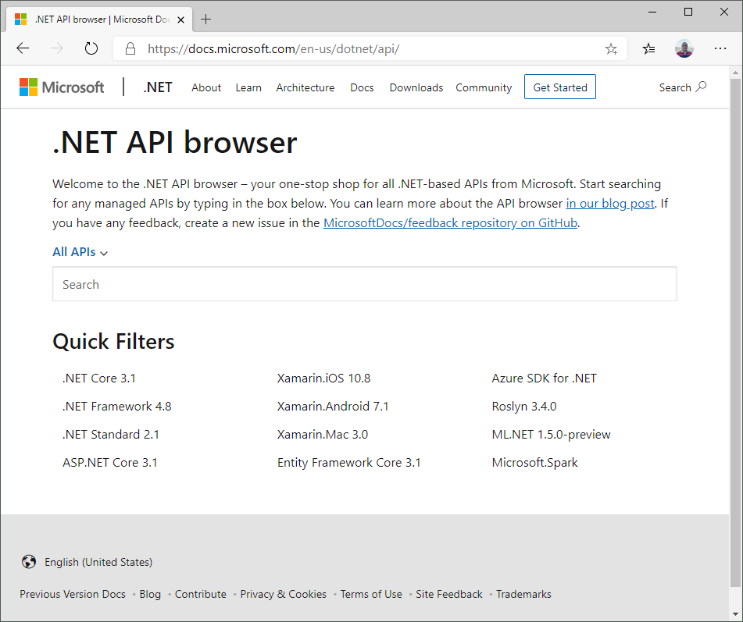
.NET API Browser
Is one-stop shop for all .NET-based APIs from Microsoft. You can search for any managed APIs in it.
https://docs.microsoft.com/en-us/dotnet/api/

Slide 27
Demo:
Open-Source ASP.NET
.NET Core on NuGet
Notes:
Demo Script:
Demo 1:
Go to github.com/aspnet and show various repositories for ASP.NET including MVC.
Demo 2:
Show various versions of .NET Core SDK, Runtime, and Tooling in GitHub.
Demo 3:
Create or open new ASP.NET Core project with starter template.
Expand Reference node under Visual Studio Project.
Expand .NET Core references, and show that .NET Core is formed by all these NuGet packages. There is no direct assembly or Globally Assembly Cache (GAC) reference.
Expand the NuGet Packages to show their dependencies. Also, show the capability to search referred NuGet packages through Solution Explorer.
Open project file .csproj and how how it is lighter than the usual csproj. The point is that it is a modular and lean framework. You only use what you need. The rest of the libraries are skipped resulting in smaller footprint of the underlying framework.

Slide 28
Demo:
.NET Standard 2.0
Notes:
Demo Script:
Create an empty project and call it NetStandardDemo
Create a .NET Standard Class library called NetStandardLib
Rename Class1 to Helper
Create a static method inside Helper class: public static DateTime GetDate() => DateTime.Now;
Create a Console App (.NET Framework) with version 4.6.1
Add a reference to NetStandardLib
Call GetDate() method from NetStandardLib
Create a Console App (.NET Core)
Add a reference to NetStandardLib
Call GetDate() method from NetStandardLib
Show that you can reference .NET standard lib and you can try with .NET framework 4.8 also.

Slide 29
Module 1: Overview
Section 2: .NET Core
Lesson: Command Line Interface (CLI)

Slide 30
.NET Core Command Line Interface (CLI)
Cross-platform toolchain for developing .NET Core applications
Primary layer built upon by Visual Studio, editors, build orchestrators, etc.
Cross-platform with same surface area for supported platforms
Language agnostic
Target agnostic
dotnet new
dotnet restore
dotnet build --output /stuff
dotnet run
dotnet stuff/new.dll
Notes:
What is the .NET Core Command Line Interface (CLI)?
The .NET Core CLI is a new foundational cross-platform toolchain for developing .NET Core applications. It is "foundational" because it is the primary layer on which other, higher-level tools, such as Integrated Development Environments (IDEs), editors and build orchestrators can build on.
It is also cross-platform by default and has the same surface area on each of the supported platforms. This means that when you learn how to use the tooling, you can use it the same way from any of the supported platforms.
Installation
As with any tooling, the first thing is to get the tools to your machine. Depending on your scenario, you can either use the native installers to install the CLI or use the installation shell script.
The native installers are primarily meant for developer's machines. The CLI is distributed using each supported platform's native install mechanism, for instance DEB packages on Ubuntu or MSI bundles on Windows. These installers will install and set up the environment as needed for the user to use the CLI immediately after the install. However, they also require administrative privileges on the machine. You can view the installation instructions on the .NET Core getting started page.
Install scripts, on the other hand, do not require administrative privileges. However, they will also not install any prerequisites on the machine; you need to install all of the prerequisites manually. The scripts are meant mostly for setting up build servers or when you wish to install the tools without administrative privileges (do note the prerequisites caveat above). You can find more information on the install script reference topic. If you are interested in how to set up CLI on your continuous integration (CI) build server you can take a look at the CLI with CI servers document.

Slide 31
CLI Command Examples
dotnet restore | Uses NuGet to restore dependencies as well as project-specific tools that are specified in the project file in parallel.
dotnet build | Restores any dependencies then builds the project and its dependencies into a set of binaries. The binaries include the project's code in Intermediate Language (IL) files with a .dll extension and symbol files used for debugging with a .pdb extension.
dotnet run | It allows you to run your application from the source code with one command. It's useful for fast iterative development from the command line. The command depends on the dotnet build command to build the code. Any requirements for the build, such as that the project must be restored first.
dotnet clean | Cleans the output of the previous build.
dotnet new web | Create a new Empty web application then restores the dependencies/packages for it.
dotnet watch | A file watcher to listen when a file change can to trigger compilation, test execution, or deployment
Notes:
dotnet build (compiles an app or library as an IL binary. In the case of an app, build generates runnable assets by copying an executable host to make the IL binary runnable. The host relies on a shared framework for dependencies, including a runtime.)

Slide 32
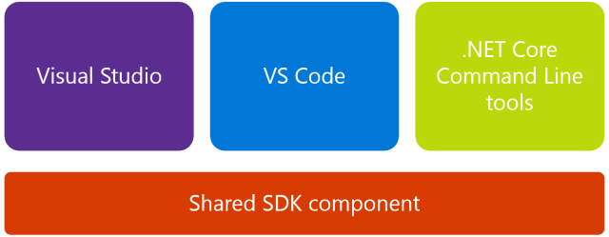
.NET Core Tooling

Slide 33
CLI dotnet new templates
Template description | Template name | Languages
Console application | console | [C#], F#, VB
Class library | classlib | [C#], F#, VB
Unit test project | mstest | [C#], F#, VB
xUnit test project | xunit | [C#], F#, VB
Razor page | page | [C#]
MVC ViewImports | viewimports | [C#]
MVC ViewStart | viewstart | [C#]
ASP.NET Core empty | web | [C#], F#
ASP.NET Core Web App (Model-View-Controller) | mvc | [C#], F#
ASP.NET Core Web App | razor | [C#]
ASP.NET Core with Angular | angular | [C#]
ASP.NET Core with React.js | react | [C#]
ASP.NET Core with React.js and Redux | reactredux | [C#]
ASP.NET Core Web API | webapi | [C#], F#
Razor class library | razorclasslib | [C#]
global.json file | globaljson
NuGet config | nugetconfig
Web config | webconfig
Solution file | sln
.NET Core have many templates from the CLI
Example:
dotnet new razor -lang c#
This will install an ASP.NET Core Web Application which using Angular and C# language
To get more template you can check https://dotnetnew.azurewebsites.net/
Notes:
You can create your own custom template and you can install it as follows
NuGet as a source:
dotnet new -i NUnit3.DotNetNew.Template
File System as a source:
dotnet new -i C:/Users/<USER>/Documents/Templates/GarciaSoftware.ConsoleTemplate.Csharp
More details can be found at [Create a custom template for dotnet new](https://docs.microsoft.com/en-us/dotnet/core/tutorials/create-custom-template)

Slide 34
.NET Core CLI Extensibility
.NET Core is built for extensibility, you extend the CLI with your own custom commands and tooling
The CLI tools can be extended in three main ways:
Via NuGet packages on a per-project basis Per-project tools are contained within the project's context, but they allow easy installation through restoration.
Via NuGet packages with custom targets Custom targets allow you to easily extend the build process with custom tasks.
Via the system's PATH PATH-based tools are good for general, cross-project tools that are usable on a single machine.
Example of extensibility is the EF Core commands
Notes:
The three extensibility mechanisms outlined above are not exclusive. You can use one, or all, or a combination of them. Which one to pick depends largely on the goal you are trying to achieve with your extension.
If you want to go deep on this topic I recommend to check this URL [.NET Core CLI tools extensibility model](https://docs.microsoft.com/en-us/dotnet/core/tools/extensibility)

Slide 35
Module 1: Overview
Section 2: .NET Core
Lesson: Global Tools

Slide 36
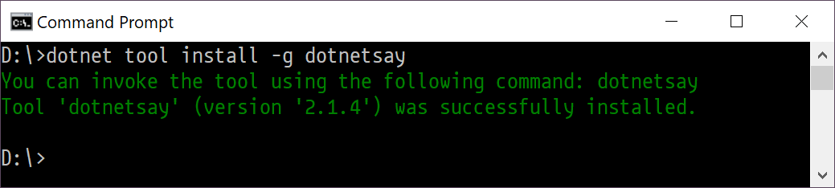
.NET Core Global Tools
.NET Core Global Tool is a special NuGet package that contains a console application.
A Global Tool can be installed on your machine on a default location that is included in the PATH environment variable or on a custom location.
To install a global tool use the following format: dotnet tool install -g <package-name> --version <version-number>
You can run the tool by typing its name like: D:\> dotnetsay

Slide 37
.NET Global Tools Examples
Code generation tool for creating controllers, views, and models in ASP.NET Core projects.
dotnet tool install -g dotnet-aspnet-codegenerator
A tool to run cross platform Cake build scripts.
dotnet tool install -g Cake.Tool
dotnet-format is a code formatter for dotnet that applies style preferences to a project or solution.
dotnet tool install -g dotnet-format
You find more at https://github.com/natemcmaster/dotnet-tools

Slide 38
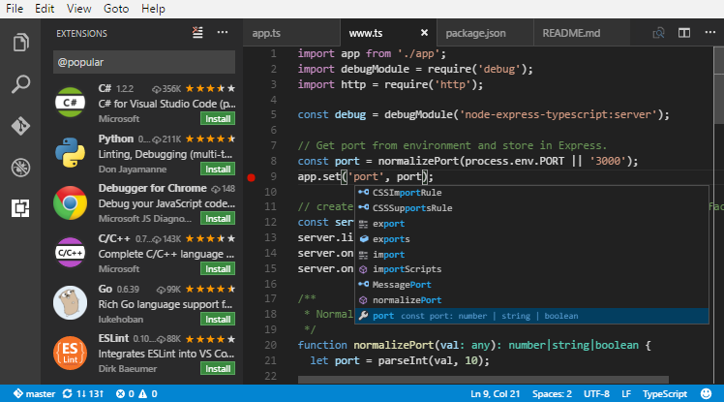
Visual Studio Code
Visual Studio Code is a lightweight but powerful source code editor which runs on your desktop.
It combines the simplicity of a source code editor with powerful developer tooling, like IntelliSense code completion and debugging.
It supports macOS, Linux, and Windows - so you can hit the ground running, no matter the platform.

Slide 39
Visual Studio Code
VS Code includes enriched built-in support for Node.js development with JavaScript and TypeScript, powered by the same underlying technologies that drive Visual Studio. VS Code also includes great tooling for web technologies such as JSX/React, HTML, CSS, SCSS, Less, and JSON.
Where to get it?
You can download for FREE for any platform from https://code.visualstudio.com/

Slide 40
Demo: .NET Core CLI & Visual Studio Code
Notes:
Demo Script:
Open Command Prompt
Navigate to a directory of choice where you want to create a sample application.
Apply the following commands:
md hwapp
cd hwapp
dotnet new mvc
dotnet run
One you created the template in step 3 the CLI will scaffold the file and execute: dotnet run
Demo 2:
Play & debug experience with Visual Studio Code.
Debugging & breakpoints
Integrated Terminal
https://code.visualstudio.com/Docs/editor/debugging

Slide 41
Module 1: Overview
Section 2: .NET Core
Lesson: .NET Runtime

Slide 42
.NET Runtimes
You can build you ASP.NET Core for a target different platforms using RIDs
Runtime IDs are values to identify the target platform which the app will run on.
RIDs can be portable (not coupled to the version of the OS) like:
win-x64
ubuntu-x64
RIDs can be coupled to the OS like:
win8-x86
osx.10.13-x64
sles.12.2-x64
RIDs that represent concrete operating systems usually follow this pattern: [os].[version]-[architecture]-[additional qualifiers]
Notes:
RIDs that represent concrete operating systems usually follow this pattern: [os].[version]-[architecture]-[additional qualifiers] where:
[os] is the operating/platform system moniker. For example, ubuntu.
[version] is the operating system version in the form of a dot-separated (.) version number. For example, 15.10.
The version shouldn't be marketing versions, as they often represent multiple discrete versions of the operating system with varying platform API surface area.
[architecture] is the processor architecture. For example: x86, x64, arm, or arm64.
[additional qualifiers] further differentiate different platforms. For example: aot or corert.

Slide 43
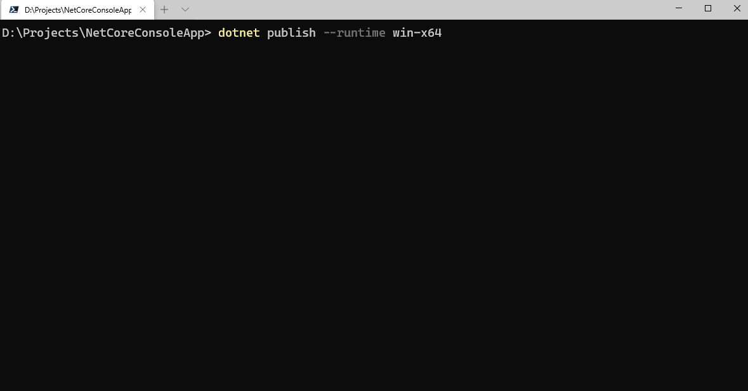
.NET Runtimes Build Command
Notes:
RIDs catalog: https://docs.microsoft.com/en-us/dotnet/core/rid-catalog
Dotnet publish: https://docs.microsoft.com/en-us/dotnet/core/tools/dotnet-publish?tabs=netcore21

Slide 44
Demo: build on windows for different runtime
Notes:
Demo Script:
Create a console app and publish it to different runtimes using the following commands
From console execute:
dotnet publish --runtime ubuntu-x64
dotnet publish --runtime win-x64
dotnet publish --runtime opensuse-x64
Show the publish folder contents
Show that the app is actually it runs on different platforms (better if you have different OS to show that)

Slide 45
Module 1: Overview
Section 2: .NET Core
Lesson: .NET Core Support Lifecycle

Slide 46
.NET Core Release Types
Long Term Support (LTS)
Designed for long-term support. They included features and components that have been stabilized, requiring few updates over a longer support release lifetime. These releases are a good choice for hosting applications that you do not intend to update.
LTS releases are supported for three years after the initial release.
Current
Includes new features that may undergo future change based on feedback. These releases are a good choice for applications in active development, giving you access to the latest features and improvements. You need to upgrade to later .NET Core releases more often to stay in support.
Current releases are supported for three months after a subsequent Current or LTS release.
More Stable ✔
More Features 👍

Slide 47
.NET Core Release Lifecycles
Version | Original Release Date | Latest Patch Version | Patch Release Date | Support Level | End of Support
.NET Core 3.1 | 03-Dec-2019 | 3.1.2 | 18-Feb-2020 | LTS | 03-Dec-2022
.NET Core 3.0 | 23-Sep-2019 | 3.0.3 | 18-Feb-2020 | EOL | 03-Mar-2020
.NET Core 2.2 | 04-Dec-2018 | 2.2.8 | 19-Nov-2019 | EOL | 23-Dec-2019
.NET Core 2.1 | 30-May-2018 | 2.1.16 | 18-Feb-2020 | LTS | 21-Aug-2021
.NET Core 2.0 | 14-Aug-2017 | 2.0.9 | 10-Jul-2018 | EOL | 01-Oct-2018
.NET Core 1.1 | 16-Nov-2016 | 1.1.13 | 14-May-2019 | EOL | 27-Jun-2019
.NET Core 1.0 | 27-Jun-2016 | 1.0.16 | 14-May-2019 | EOL | 27-Jun-2019
* These dates are taken in March 2020 * EOL: End of Life: End of support refers to the date when Microsoft no longer provides fixes, updates, or online technical assistance.
* Highlighted in RED are out of support * Source: https://dotnet.microsoft.com/platform/support/policy/dotnet-core
Notes:
Link: https://dotnet.microsoft.com/platform/support/policy/dotnet-core

Slide 48
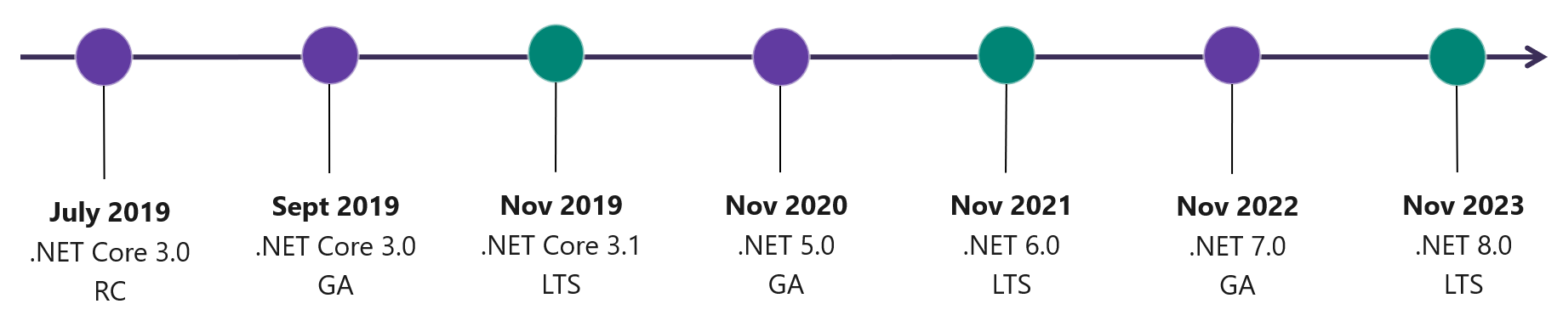
.NET Roadmap
Milestone | Release Date
.NET Core 2.1.x (servicing) | LTS (Long Term Support) release. Approximately every 1-2 months or as needed.
.NET Core 3.1.x (servicing) | LTS (Long Term Support) release. Approximately every 1-2 months or as needed.
.NET 5.0 | Release scheduled for November 2020
.NET 6.0 | LTS (Long Term Support) release, scheduled for November 2021
.NET 7.0 | Release scheduled for November 2022
.NET 8.0 | LTS (Long Term Support) release, scheduled for November 2023
Notes:
More can be found => https://github.com/dotnet/core/blob/master/roadmap.md

Slide 49
.NET Core Repositories
https://github.com/dotnet/runtime Contains the code to build the .NET Core runtime, libraries and shared host (dotnet) installers for all supported platforms, as well as the sources to .NET Core runtime and libraries.
https://github.com/dotnet/sdk Contains core functionality needed to create .NET Core projects, that is shared between Visual Studio and CLI.
https://github.com/dotnet/aspnetcore Contains the code for asp.net core plus the following:
Documentation - documentation sources for https://docs.microsoft.com/aspnet/core/
Entity Framework Core - data access technology
Extensions - Logging, configuration, dependency injection, and more.

Slide 50
Other .NET Repositories
https://github.com/aspnet/AspNetWebStack Code for ASP.NET MVC 5.x, Web API 2.x, and Web Pages 3.x. For ASP.NET Core MVC
https://github.com/dotnet/winforms Code for WinForms, Windows Forms is a UI framework for building Windows desktop applications.
https://github.com/dotnet/ef6 codebase for Entity Framework 6 (previously maintained at https://entityframework.codeplex.com).

Slide 51
Additional Repos
There are more repos can be found under the following organizations
https://github.com/dotnet
https://github.com/aspnet
https://github.com/microsoft
https://github.com/azure
https://github.com/sharepoint

Slide 52
Module Summary
In this module, you learnt the following:
.NET Platform Overview
.NET Standard
.NET Core CLI
.NET Core Global Tools
.NET Runtimes
.NET Core Support Lifecyle
.NET Roadmap
.NET Repositories

Slide 53


